Slide 1
Ethical Feedback using a Facilitator Lens
Notes:
What is the role of a facilitator when I give written feedback?

Slide 2
Outcomes
Develop an Awareness through discussion and sharing of ideas in order to maintain Ethical Written feedback
Confirm and Extend how building the relationship supports Effective Ethical Feedback

Slide 3
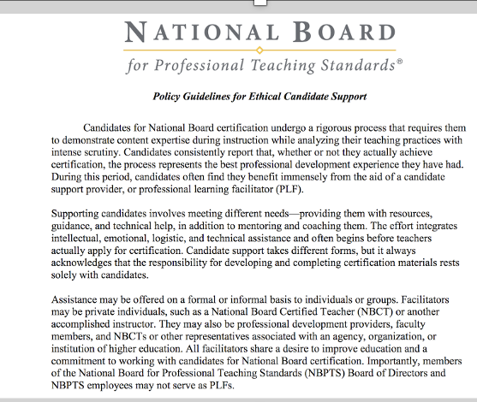
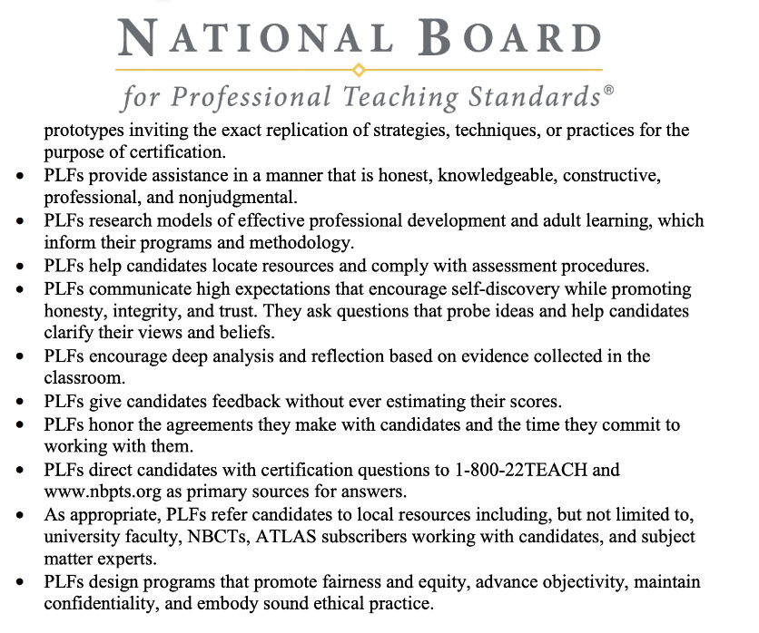
Policy Guidelines
for Ethical Candidate Support
Notes:
https://www.nbpts.org/wp-content/uploads/2021/10/Ethical-Guidelines-Candidate-Support-1.pdf

Slide 4
Maintain a clear distinction between personal opinions and NBPTS policies
Provide assistance in a manner that is honest, knowledgeable, constructive, professional, and nonjudgmental
Communicate high expectations that encourage self-discovery while promoting honesty, integrity, and trust
Ask questions that probe ideas and help candidates clarify their views and beliefs
Encourage deep analysis and reflection based on evidence collected in the classroom
How do I.…..
Notes:
How do I maintain Ethical feedback in Writing?

Slide 5
Maintain a clear distinction between personal opinions and NBPTS policies
How do I….

Slide 6
How do I….
Provide assistance in a manner that is honest, knowledgeable, constructive, professional, and nonjudgmental

Slide 7
How do I….
Communicate high expectations that encourage self-discovery while promoting honesty, integrity, and trust

Slide 8
Ask questions that probe ideas and help candidates clarify their views and beliefs
How do I….

Slide 9
Encourage deep analysis and reflection based on evidence collected in the classroom
How do I….

Slide 10
How does building a relationship assist in providing ethical written feedback?
Creating a recipe for effective feedback
Notes:
How does ethical feedback become effective?
What makes feedback effective?

Slide 11
Mentor Coach Training Dates
November 5, 2022 New
January 12, 2023 New
January 28, 2023 Readers Refresher

Slide 12
Exit Survey
What from this breakout gave you insight into maintaining ethical feedback?
What do you envision you may need to further your development of ethical feedback?
Notes:
Link to my feedback form for this session to go in chat:
Ethical Feedback Aug. 2022

