Slide 1
National Board Certification for Teachers in Illinois

Slide 2
What is National Board Certification?
“National Board Certified Teachers have demonstrated that they have met the profession’s highest standards for accomplished practice through a rigorous, performance-based, peer-review process.”
-NBPTS

Slide 3
Why National Board Certification?
Established in 1987, the National Board for Professional Teaching Standards is an independent, nonprofit organization working to advance accomplished teaching for all students.
More than a decade of research from across the country confirms that students taught by National Board Certified Teachers (NBCTs) learn more than students taught by non-NBCT teachers.
97% of teachers change their teaching after going through the National Board process.
To learn more, go to: https://www.nbpts.org/research/

Slide 4
Benefits of Becoming a National Board Certified Teacher
Illinois Licensing offers:
Only avenue to earn the Master Teacher designation on Illinois professional educator license (PEL).
Reduction (by ½) of professional development requirements for 5 years.
Illinois One-Time $3,000 Incentive for NBCTs in EBF Tier 1and 2 Rural & Remote Districts or Schools.
lllinois Offers NBCTs:
$1,500 for providing 30 hours of mentoring or professional development.
Specific to School District:
Contact your school district for information for district benefits (lane change, stipend, leadership roles, etc.)
Credits must be accepted by an accredited university in order to count towards an advanced degree or by a school district for salary lane movement.)

Slide 5
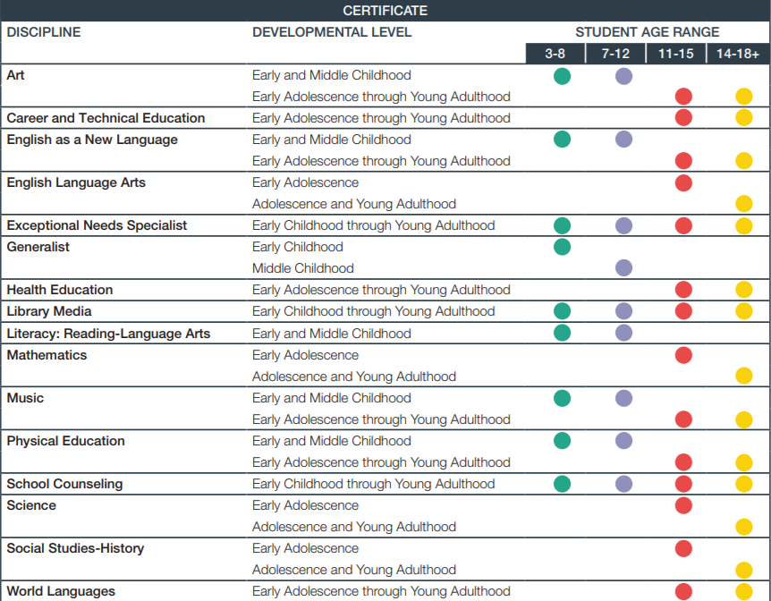
Differentiated Professional Development for Teachers and Counselors
Certifications in:
25 areas
16 disciplines
6 levels

Slide 6
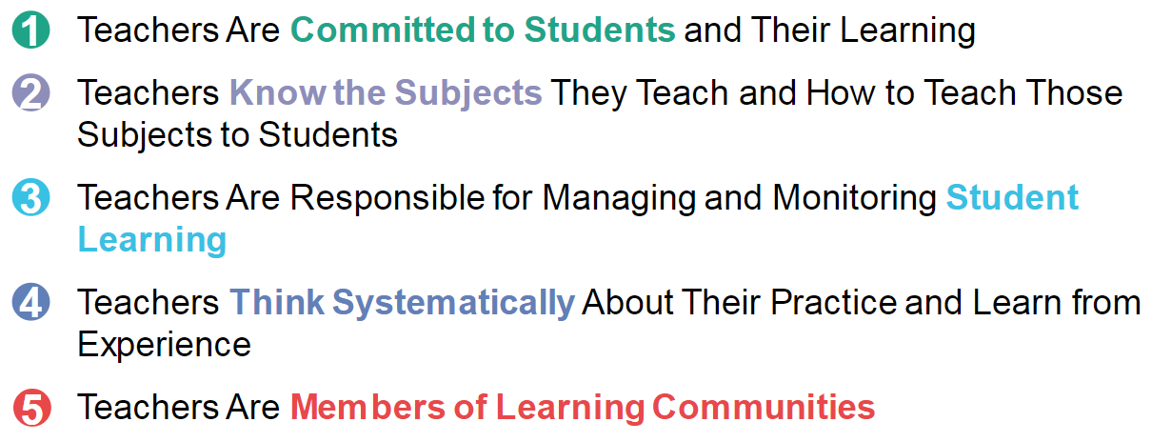
5 Core Propositions of National Board

Slide 7
National Board Professional Teaching Standards
Example: Science Standards
Standard I: Understanding Students
Standard II: Knowledge of Science
Standard III: Curriculum and Instruction
Standard IV: Assessment
Standard V: Learning Environment
Standard VI: Family and Community Partnerships
Standard VII: Advancing Professionalism
Standard VIII: Diversity, Fairness, Equity, and Ethics
Standard IX: Reflection

Slide 8
Architecture of Accomplished Teaching
Set new high and worthwhile goals that are appropriate for these students at this time.
START HERE:
ASSESSMENT OF STUDENTS
Who are they?
Where are they now?
What do they need and
when do they need it?
Where should I begin?
Reflect on student learning, the effectiveness of instructional design, particular concerns and issues.
Provide timely, meaningful feedback to students about their level of accomplishment of the targeted goals.
Set high, worthwhile goals appropriate for these students, at this time, in this setting.
Design and implement instruction designed to attain these goals.
Evaluate student learning in light of the goals and the instruction.

Slide 10
National Board’s Core Propositions Aligned to Illinois Standards and Professional Learning See detailed alignment:
Crosswalk of Illinois Education Initiatives and National Board Certification (illinoisstate.edu)

Slide 11
Eligibility for NB Certification
Qualifications:
1) Hold a valid Illinois teaching license;
2) Have a bachelor’s degree; and
3) Currently teaching full-time in a public school.

Slide 12
What is the NB Process?
Four Components to the Process
Component 1 - Content Knowledge
Component 2 - Differentiation in Instruction
Component 3 - Teaching Practice and
Classroom Environment
Component 4 - Effective and Reflective
Practitioner

Slide 13
The National Board Process 4 Components:

Slide 15
How does a teacher or counselor become a NBCT?
Component 1
accounts for 40% of total score
Components 2, 3, and 4
account for 60% of total score
The four components are scored after submission and must collectively reach an established level.

Slide 16
How long does the NB process take?
The 4 components can be completed in 1 year, but a teacher or counselor is allowed 3 years to complete.
The 4 components are usually completed in 2 years.
A candidate can retake components for 2 years after intital submission and scoring.

Slide 17
2023-2024
C2: Differentiation in Instruction
C1: Content Knowledge
C3: Teaching Practice and Learning Environment
C4: Effective and Reflective Practitioner
2024-2025

Slide 18
Illinois Financial Support
The total costs of NB certification will be $1,900 – paid by ISBE if eligible
Includes all four components
ISBE will make payments for these components directly to NBPTS
The only expense to teachers is the $75 NBPTS registration fee

Slide 19
State Funding
To be eligible:
Be a teacher or counselor;
Teach in an Illinois public school;
Hold a valid Illinois Professional Educator License (PEL);
Hold a valid Illinois Educator Identification License Number (IEIN); and
Be a first-time applicant who has not used the Illinois NB fee subsidy in past years.

Slide 20
How to Apply for State Funding
The Spring 2023 window for the
Illinois NBPTS Candidate Fee Subsidy
opens on March 1, 2023, at 10:00 AM – closes May 10, 2023, at midnight.
Go here to apply:
https://nbrc.illinoisstate.edu/firsttime/index.php

Slide 21
Teachers/counselors support:
Face-to-Face Cohorts
Virtual Cohorts
Professional Development School Cohorts
Regional Office of Education Cohorts
ISU Graduate Class
Certificate-Alike Webinars
Individual Mentors/Coaches

Slide 22
1st Time Candidate Support
Face-to-Face Cohorts:
Candidates are grouped by locality and provided the professional development necessary for the completion of the components is presented by a trained NBCT Facilitator.
Virtual Cohorts:
Candidates are provided the professional development necessary for the completion of the components online, presented by a trained NBCT Facilitator.
ROE Cohorts:
Select ROEs operate cohorts in rural areas of the state.

Slide 23
Certificate-Alike Webinars
Two virtual opportunities throughout the year to talk to others in their own certificate area
Collaborate, share ideas, express concerns
Led by trained NBCT Facilitator
Mentor/Coach
Assists candidate 1:1
Trained to ethically mentor/coach

Slide 24
National Board Resource Center
The National Board Resource Center:
Oversees the state grants that enable the National Board Certified Teacher program in Illinois.
Pays teacher fees for participation through the ISBE grant.
Provides support through the NB process.
Oversees the grant that enables payment for NBCTs who mentor or provide professional development in schools.

Slide 25
National Board Professional Development School
Shared Leadership of the Cohort
Collaboration among an administrator overseeing the program, a NBCT, and Teacher-Candidates
Held in a school/district
Focus on a common school improvement goal
Training provided by NBRC
*If you are interested in learning more about how to become an NB PD School, contact NBRC at 309-438-1835 or jsmit31@ilstu.edu

Slide 26
Resources
NBPTS website
www.nbpts.org
ISBE website
https://www.isbe.net/Pages/National-Board-Certified-Teachers.aspx
NBRC at ISU website
http://www.nbrc.illinoisstate.edu

Slide 27
Questions?
Jennifer Smith, Director
National Board Resource Center
Illinois State University
jsmit31@ilstu.edu
(309) 438-1835
https://nbrc.illinoisstate.edu/
Twitter @NBRCIllinois
Facebook: National Board Resource Center at Illinois State University

