Slide 1
National Board Certification for Teachers in Illinois
Notes:
Hi. My name is Sheri Bettis from the National Board Resource Center at Illinois State University. I am here to tell you about National Board Certification for teachers and counselors in Illinois.
This is a collaborative effort among the National Board Professional Teaching Standards, the Illinois State Board of Education, and the National Board Resource Center.

Slide 2
What is National Board Certification?
“National Board Certified Teachers have demonstrated that they have met the profession’s highest standards for accomplished practice through a rigorous, performance-based, peer-review process.”
-NBPTS
Notes:
What does it mean to become a national board-certified teacher?
It means that you have proven that you have met the profession’s highest standards for teaching excellence. This could be equated to an accountant that becomes a CPA. We believe that National Board Certification elevates the teaching profession.

Slide 3
Why National Board Certification?
Established in 1987, the National Board for Professional Teaching Standards is an independent, nonprofit organization working to advance accomplished teaching for all students.
More than a decade of research from across the country confirms that students taught by National Board Certified Teachers (NBCTs) learn more than students taught by non-NBCT teachers.
97% of teachers change their teaching after going through the National Board process.
To learn more, go to: https://www.nbpts.org/research/
Notes:
Why did Illinois choose to partner with National Board? National Board is a non-profit organization committed to improving student learning and teaching practice. More than a decade of research from across the country confirms that students taught by National Board Certified Teachers outperform their peers that are taught by non-National Board Certified Teachers. Additionally, 97% of teachers report that they change their classroom practices after going through the process towards certification.

Slide 4
Benefits of Becoming a National Board Certified Teacher
Illinois Licensing offers:
Only avenue to earn the Master Teacher designation on Illinois professional educator license (PEL).
Reduction (by ½) of professional development requirements for 5 years.
Illinois One-Time $3,000 Incentive for NBCTs in EBF Tier 1and 2 Rural & Remote Districts or Schools.
Illinois Offers NBCTs:
$2,250 for providing 45 hours of mentoring or professional development.
Specific to School District:
Contact your school district for information for district benefits (lane change, stipend, leadership roles, etc.)
Credits must be accepted by an accredited university in order to count towards an advanced degree or by a school district for salary lane movement.)
Notes:
What are the benefits of becoming a National Board Certified Teacher?
First, in Illinois, if you become a national board certified teacher, a special Master Teacher designation is placed on your license. Earning National Board Certification is the only method for obtaining this designation.
Second, there is a reduction of professional development requirements for licensure from 120 to 60 hours for the length of your certification.
Third, there is an offer to NBCT’s of a $2,250 annual payment for providing up to 45 hours of mentoring or professional development. This could include leading candidates through the national board process.
Fourth, On January 1, 2020, Public Act 101-0333 went into effect. This law contains an amendment that includes a $3000 incentive for National Board Certified Teachers in EBF Tier 1 and 2 rural and remote school districts or schools.
Lastly, many districts in the state of Illinois offer incentives (such as a stipend) to employees who earn certification. You will want to visit with your administration or union representation to obtain specifics pertaining to your district.

Slide 5
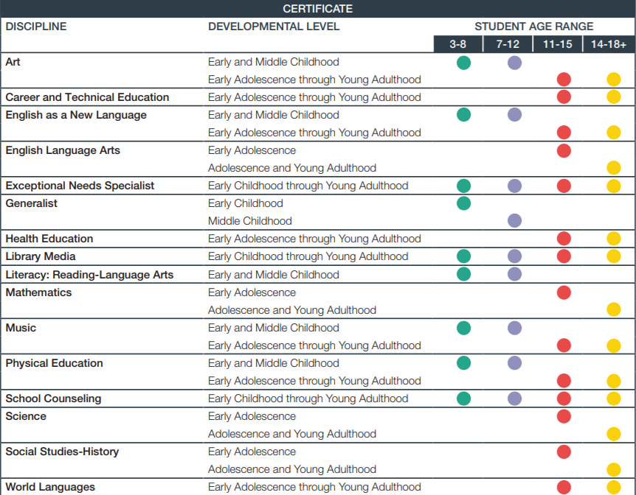
Differentiated Professional Development for Teachers and Counselors
Certifications in:
25 areas
16 disciplines
6 levels
Notes:
National Board differentiates for educators. There are 25 certification areas, 16 disciplines, and 6 levels. If you are wanting more information about the certificate areas, there is a link at the end of this presentation to the National Board website. On the website you will be able to find specifics about the certification areas, disciplines, and levels.

Slide 6
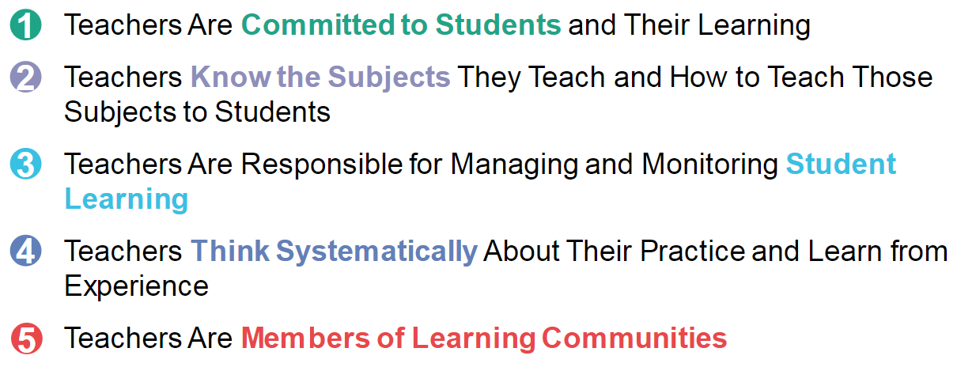
5 Core Propositions of National Board
Notes:
National Board process asks candidates to provide evidence towards 5 core propositions. These 5 core propositions are outlined on the slide.

Slide 7
National Board Professional Teaching Standards
Example: Science Standards
Standard I: Understanding Students
Standard II: Knowledge of Science
Standard III: Curriculum and Instruction
Standard IV: Assessment
Standard V: Learning Environment
Standard VI: Family and Community Partnerships
Standard VII: Advancing Professionalism
Standard VIII: Diversity, Fairness, Equity, and Ethics
Standard IX: Reflection
Notes:
Additionally, National Board has standards that are applicable to each certificate area. To provide an example, the standards for science are provided. These include understanding students, knowledge of content, …… and reflection. You may have already been exposed to the National Board standards and haven’t been aware of it. As an example – if you have heard of Educator’s Rising for pre-service teachers – this is based on National Board standards. It is our goal at the National Board Resource Center for all students to have National Board Certified Teachers in their classrooms. And it is our hope that National Board Certified Teachers will move on to become teacher or school leaders.

Slide 8
Architecture of Accomplished Teaching
Set new high and worthwhile goals that are appropriate for these students at this time.
START HERE:
ASSESSMENT OF STUDENTS
Who are they?
Where are they now?
What do they need and
when do they need it?
Where should I begin?
Reflect on student learning, the effectiveness of instructional design, particular concerns and issues.
Provide timely, meaningful feedback to students about their level of accomplishment of the targeted goals.
Set high, worthwhile goals appropriate for these students, at this time, in this setting.
Design and implement instruction designed to attain these goals.
Evaluate student learning in light of the goals and the instruction.
Notes:
The National Board process guides teachers through an Architecture of Accomplished teaching that focuses on students, data driven decisions, teaching practices, evaluation, and reflection.

Slide 9
Notes:
As you can see, the Architecture of Accomplished teaching is tied to the Danielson Framework as well as other state of Illinois initiatives.

Slide 10
National Board’s Core Propositions Aligned to Illinois Standards and Professional Learning See detailed alignment:
Crosswalk of Illinois Education Initiatives and National Board Certification (illinoisstate.edu)
Notes:
Information on Illinois initiatives and their connection to National Board certification can be found on this web page.

Slide 11
Eligibility for NB Certification
Qualifications:
1) Hold a valid Illinois teaching license;
2) Have a bachelor’s degree; and
3) Currently teaching full-time in a public school.
Notes:
How do you know if you are eligible for National Board certification? The three qualifications are listed here.

Slide 12
What is the NB Process?
Four Components to the Process
Component 1 - Content Knowledge
Component 2 - Differentiation in Instruction
Component 3 - Teaching Practice and
Classroom Environment
Component 4 - Effective and Reflective
Practitioner
Notes:
Now, let’s explore the National Board process. There are a total of four components.

Slide 13
The National Board Process 4 Components:
Notes:
Component 1 assesses knowledge of content and how the content is taught in the classroom. It is an assessment-based component.
Component 2 is a portfolio styled entry that will ask you to gather and analyze information on students and their needs. You will then use that data to implement instruction to advance student learning.

Slide 14
Notes:
Component 3 includes creating video recordings in the classroom and submitting these along with your own writing where you analyze and reflect upon the teaching and interactions that are seen within the recordings.
Component 4 is another portfolio styled entry that will ask you to demonstrate your abilities to advance student learning through things such as analysis of data, using that data to drive decisions in the classroom, and reflection.

Slide 15
How does a teacher or counselor become a NBCT?
Component 1
accounts for 40% of total score
Components 2, 3, and 4
account for 60% of total score
The four components are scored after submission and must collectively reach an established level.
Notes:
You may be wondering how a teacher or counselor in Illinois becomes certified. In Illinois, it is a two year process. After you complete the four components, you submit them to National Board and they are scored to determine if they collectively reach a pre-established level. This level is determined by National Board.
If certification is not obtained and a component needs to be retaken, the state of Illinois will support the candidate through the retake process both financially and through professional development opportunities.

Slide 16
How long does the NB process take?
The 4 components can be completed in 1 year, but a teacher or counselor is allowed 3 years to complete.
The 4 components are usually completed in 2 years.
A candidate can retake components for 2 years after intital submission and scoring.
Notes:
In Illinois, the process is supported for two years. However, it can be completed in one year while teachers and school counselors are allowed up to three years to complete the process.
Also, if a candidate does not achieve certification on the first attempt, they have two years to retake a component. Again, the state of Illinois will support you through the retake process.

Slide 17
2023-2024
C2: Differentiation in Instruction
C1: Content Knowledge
C3: Teaching Practice and Learning Environment
C4: Effective and Reflective Practitioner
2024-2025
Notes:
Illinois will support components 1 and 3 during the 2023-2024 school year and components 2 and 4 during the 2024-2025 school year.

Slide 18
Illinois Financial Support
The total costs of NB certification will be $1,900 – paid by ISBE if eligible
Includes all four components
ISBE will make payments for these components directly to NBPTS
The only expense to teachers is the $75 NBPTS registration fee
Notes:
The cost for National Board certification is $1900. If eligible, the Illinois State Board of Education will pay the fees upfront for candidates. This would include all four components.

Slide 19
State Funding
To be eligible:
Be a teacher or counselor;
Teach in an Illinois public school;
Hold a valid Illinois Professional Educator License (PEL);
Hold a valid Illinois Educator Identification License Number (IEIN); and
Be a first-time applicant who has not used the Illinois NB fee subsidy in past years.
Notes:
There are requirements that must be met to be eligible for the state of Illinois funding. These requirements are listed.

Slide 20
How to Apply for State Funding
The Fall 2023 window for the
Illinois NBPTS Candidate Fee Subsidy
opens on September 1, 2023, at 10:00 AM – closes October 11, 2023, at midnight.
Go here to apply:
https://nbrc.illinoisstate.edu/firsttime/index.php
Notes:
Teacher and counselors can apply for the Illinois Candidate Subsidy Fee from September 01, 2023, until October 11, 2023. Please remember that as a candidate you are supported throughout the two-year process and will be focusing on two components per year.

Slide 21
Teachers/counselors support:
Face-to-Face Cohorts
Virtual Cohorts
Professional Development School Cohorts
Regional Office of Education Cohorts
ISU Graduate Class
Certificate-Alike Webinars
Individual Mentors/Coaches
Notes:
Teachers and counselors are supported through the process in collaborative ways and the candidate can choose which method of support that they would like to receive.

Slide 22
1st Time Candidate Support
Face-to-Face Cohorts:
Candidates are grouped by locality and provided the professional development necessary for the completion of the components is presented by a trained NBCT Facilitator.
Virtual Cohorts:
Candidates are provided the professional development necessary for the completion of the components online, presented by a trained NBCT Facilitator.
ROE Cohorts:
Select ROEs operate cohorts in rural areas of the state.
Notes:
A first-time candidate has the option of choosing face-to-face, virtual, or Regional Office of Education cohorts. The ROE cohorts occur primarily in rural areas of the state and candidates meet as a group through the Regional Office of Education. The professional development that is provided in each of these options is presented by trained National Board Certified Teacher facilitators.

Slide 23
Certificate-Alike Webinars
Two virtual opportunities throughout the year to talk to others in their own certificate area
Collaborate, share ideas, express concerns
Led by trained NBCT Facilitator
Mentor/Coach
Assists candidate 1:1
Trained to ethically mentor/coach
Notes:
Other opportunities for support include certificate alike webinars that are held two times per year. Let’s say that you are on the only person pursuing certification in ECYA Health Education in your cohort. The certificate alike webinars allow you to talk with other educators around the state that are also in your certificate area. The webinars are led by trained National Board Certified Teacher facilitators.
Also, our office will match you with a mentor/coach that will provide individual support to you as well.

Slide 24
National Board Resource Center
The National Board Resource Center:
Oversees the state grants that enable the National Board Certified Teacher program in Illinois.
Pays teacher fees for participation through the ISBE grant.
Provides support through the NB process.
Oversees the grant that enables payment for NBCTs who mentor or provide professional development in schools.
Notes:
The National Board Resource Center that is located at Illinois State University oversees the grants that enable to Illinois National Board program. Our center processes candidates for the state of Illinois, pays for the fees for participation through the Illinois State Board of Education grant, and organizes and provides support and professional development through the National Board process. National Board is a non-profit organization, but there is money involved for things such as payment to scorers and assessment centers, the development of materials, and the like.

Slide 25
National Board Professional Development School
Shared Leadership of the Cohort
Collaboration among an administrator overseeing the program, a NBCT, and Teacher-Candidates
Held in a school/district
Focus on a common school improvement goal
Training provided by NBRC
*If you are interested in learning more about how to become an NB PD School, contact NBRC at 309-438-1835 or slbetti1@ilstu.edu
Notes:
You may have been approached my someone in your district to join a National Board Professional Development School is located at your school or in your district. This model of support is a professional development cohort that is centered on a School Improvement Goal while completing the National Board Components. It is a collaborative effort among administration, a National Board Certified Teacher facilitator, and teacher-candidates. If interested, please contact NBRC to schedule a meeting.

Slide 26
Resources
NBPTS website
www.nbpts.org
ISBE website
https://www.isbe.net/Pages/National-Board-Certified-Teachers.aspx
NBRC at ISU website
http://www.nbrc.illinoisstate.edu

Slide 27
Questions?
Sheri L. Bettis, M.Ed., Interim Director
National Board Resource Center
Illinois State University
slbetti1@ilstu.edu
(309) 438-1835
https://nbrc.illinoisstate.edu/
Instagram: NBRCIllinois
Twitter @NBRCIllinois
Facebook: National Board Resource Center at Illinois State University
Notes:
I wish you the best on your National Board journey.

